Slide 1
DP-GEN: A concurrent learning platform for the generation of reliable deep learning based potential energy models
钟赟
2020/5/12

Slide 2
Background
Data generation (much less efforts)
how to generate truly representative dataset train the ML-based PES
active learning -> “concurrent learning”
ML-based
PES models
Model construction (most discussed)
A good functional form (kernel or neural network)
physical constraints

Slide 3
Background : concurrent learning
Use different sampling techniques (such as direct MD at different thermodynamic conditions, enhanced sampling, Monte Carlo) based on the current approximation of the PES to explore the configuration space
An efficient error indicator : monitor the snapshots generated during the sampling process. Those that have significant errors will then be selected and sent to a labeling procedure, in which accurate ab initio energies and forces are calculated and added to the training dataset.
A new approximation of the PES is obtained by training with the accumulated training dataset
Convergence : the configuration space has been explored sufficiently, and a representative set of data points has been accurately labeled.

Slide 4
Introduction
DP-GEN
an open-source concurrent learning platform or the generation of reliable deep learning based PES models, in a way that minimizes the computational cost and human intervention.
Scheduler
incorporate different methods or
software packages
Task dispatcher
handle a huge number of tasks ,
compatible with different kinds of machines and popular job scheduling systems

Slide 5
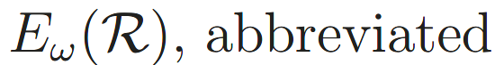

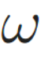
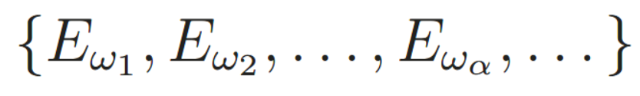
Method : Representation
: the PES
: an ensemble of models trained from same dataset but with different parameters
: atomic positions
: the parameters
Loss function
different initialization of parameters
the different PES models should produce close predictions
the variance of the ensemble of predictions used as an error indicator

Slide 6
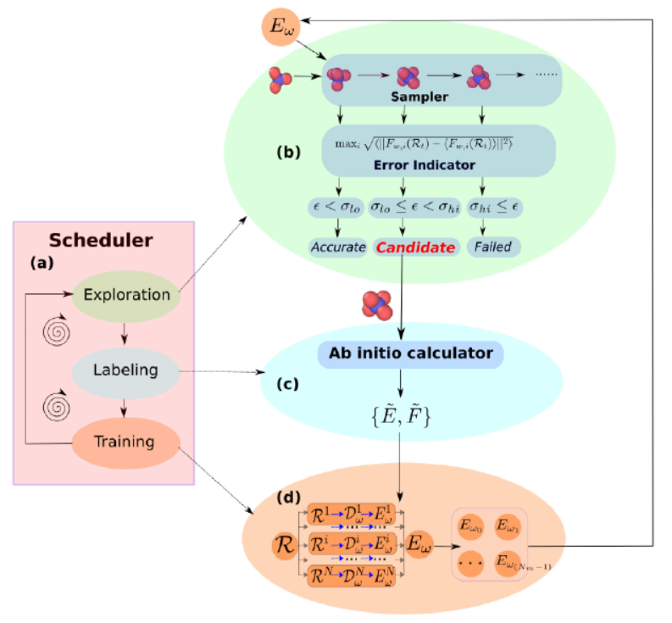
Method
Exploration
sample configurations
Labeling
compute first-principle E and F
Training
an ensemble of DP models

Slide 7

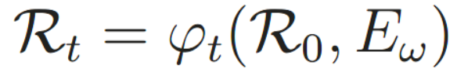
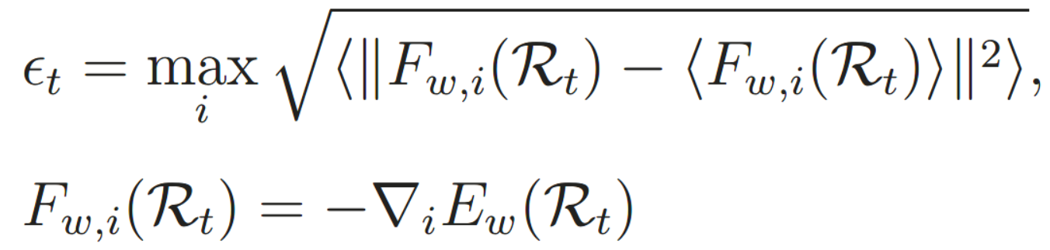
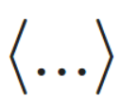
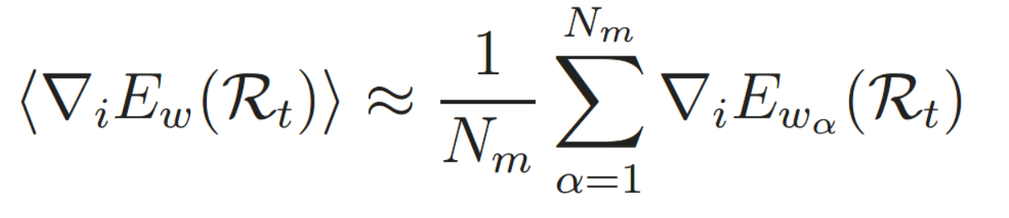
Method : Exploration
A sampler: efficiently explore the configuration space
Given an initial configuration
ϕt : direct MD, enhanced sampling, Monte Carlo…
t : labeling a continuous, or discrete series of operations
An error indicator
Given a configuration
Fw,i : the predicted force on the atom with index i, ∇i : the derivation coordinate of the i-th atom
The ensemble average :

Slide 8
Method : Labeling
Candidates for labeling
Trust levels of model deviations ε: upper bound σhi and lower bound σlo
Calculate ab initio energies and forces
first-principles-based schemes: quantum chemistry, quantum Monte Carlo, and DFT…
add labels into the training dataset for retraining

Slide 9
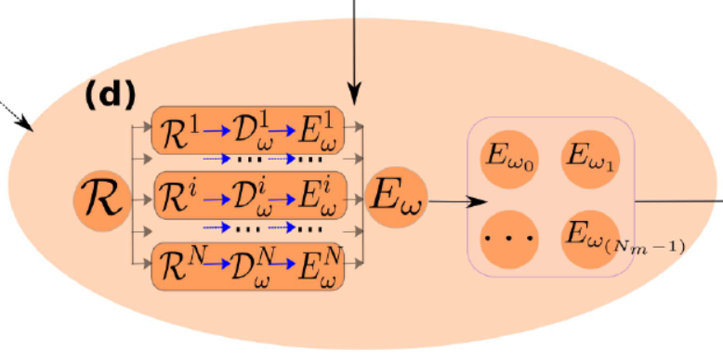
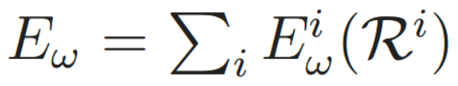
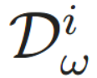
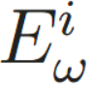
Method : Training
DP model
embedding net -> feature matrix
fitting net ->

Slide 10
Method : Exploration : copper system
the thermodynamic range of temperature from 0K to 2Tm and pressure from 1 Bar to 50,000 Bar, where Tm denotes the melting point at the ambient condition
Temperature
[50K, 0.5Tm)
[0.5Tm, Tm)
[Tm, 1.5Tm)
[1.5Tm, 2Tm)
initial conf
randomly perturbing standard crystal structures
8 iterations with increasing number of MD simulations
explore 5 temperatures
and 8 pressure conditions
record conf along MD trajectory
Δt = 0.02ps
ε
ε
σlo ~ σhi
0.05eV/ ~ 0.20eV/

Slide 11
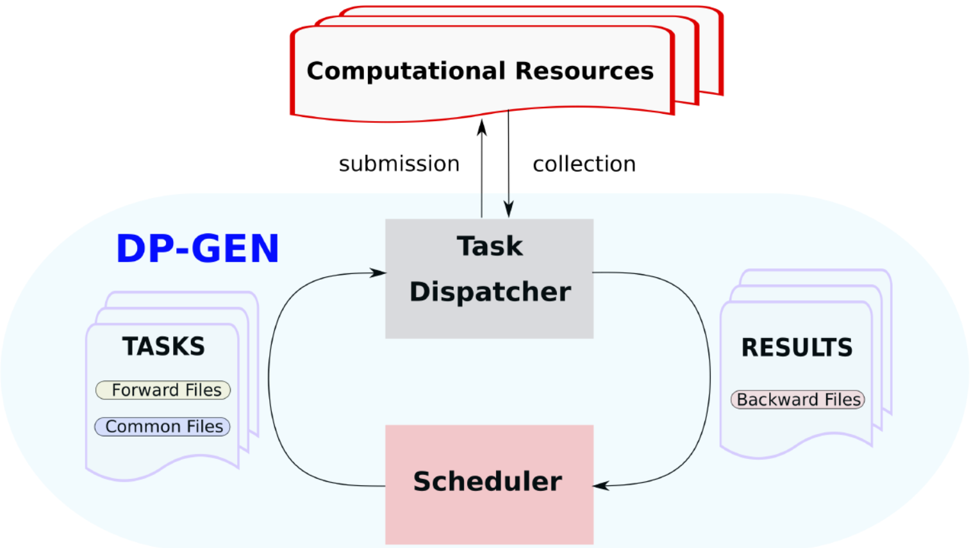
Software
Forward Files
specific for different tasks
Common Files
universal settings

Slide 12
Software : Scheduler
always works on master process
Exploration
use LAMMPS
prepares exploration tasks: DP models, input files, initial structure
collects configurations sampled by LAMMPS
Labeling
supports VASP, Quantum Espresso, Gaussian, CP2K
receive first-principle energies, forces, and/or virials
Training
use DeePMD-kit package
input training data and input files
receive several DP models

Slide 13
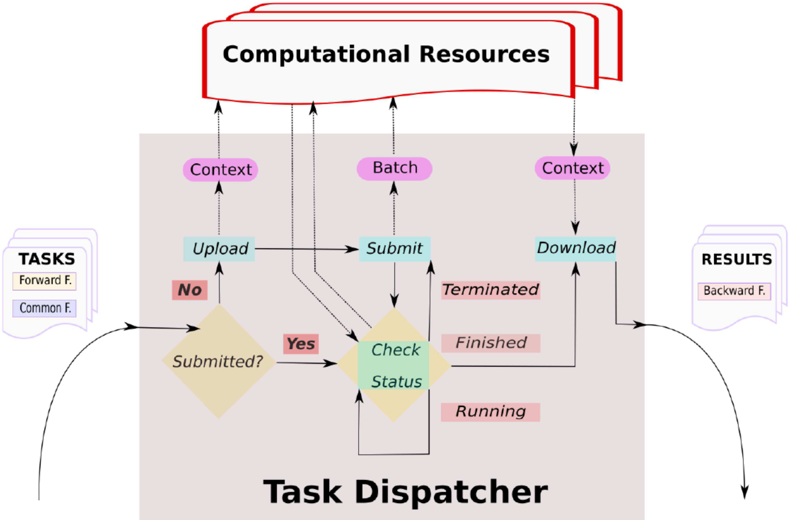
Software : Task dispatcher

Slide 14
Software : Task dispatcher
Check submission
Not submitted: construct submission script, add to queue
Submitted: collect results from finished tasks, avoid repeated computation
File uploading and downloading
DP-GEN master process on HPC
shares file system with computational nodes
I/O efficiency : symbolic links or directly moves files
DP-GEN master process not on HPC
files transmitted via ssh

Slide 15
Software : Task dispatcher
Job submission
Job scripts : adaptive to different kinds of machines
Workstation: directly execute
HPCs with a job scheduling system: setting in the submission scripts
Cloud machines: similar to one for workstation + additional commands
Job monitoring
Running -> do nothing
Terminated -> resubmit the job up to 3 times -> user intervention
Finished -> downloads the backward files and passes them to the scheduler

Slide 16
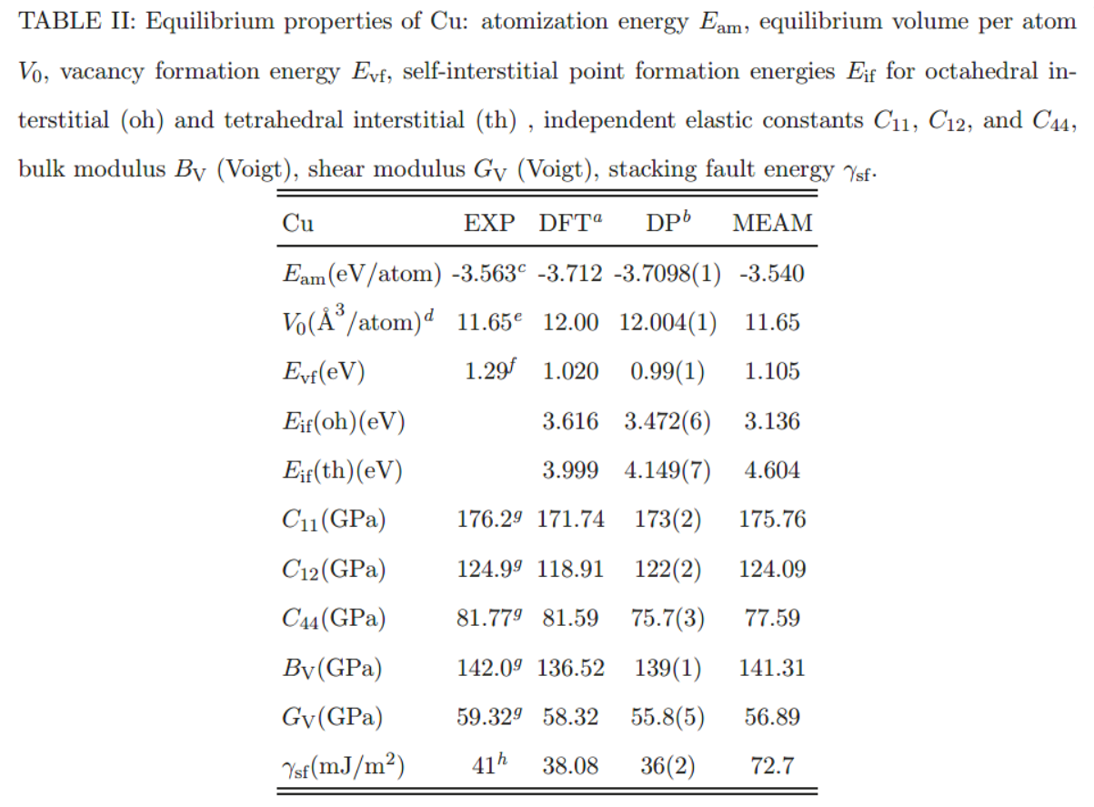
Examples : Cu
LAMMPS for exploration VASP 5.4.4 for labeling DeePMD-kit for training
Training and exploration : single card of Tesla-P100 for each calculation task
Labeling : Intel(R) Xeon(R) Gold 5117 CPU @ 2.00GHz with 28 CPU cores
Notes:
modified embedded atom method (MEAM) , a state-of-the-art empirical FF model

Slide 17
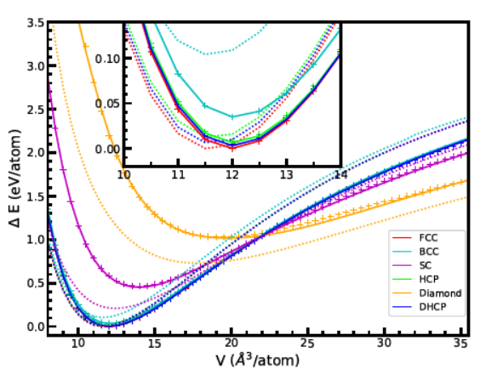
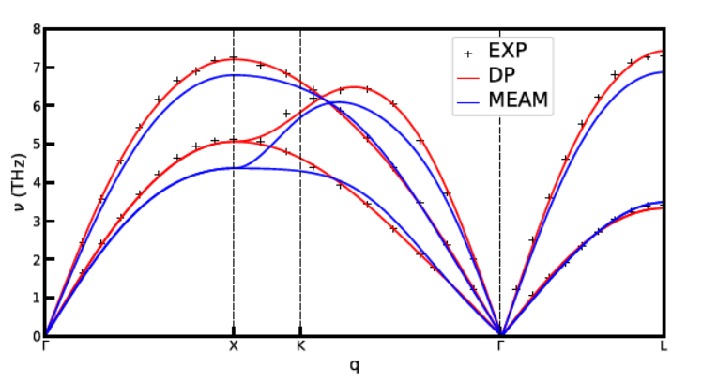
Examples : Cu
Notes:
standard crystalline structures : fcc, hcp, double hexagonal close-packed (dhcp), bcc, simple cubic (sc) and diamond
phonon dispersion relations ：声子色散关系

Slide 18
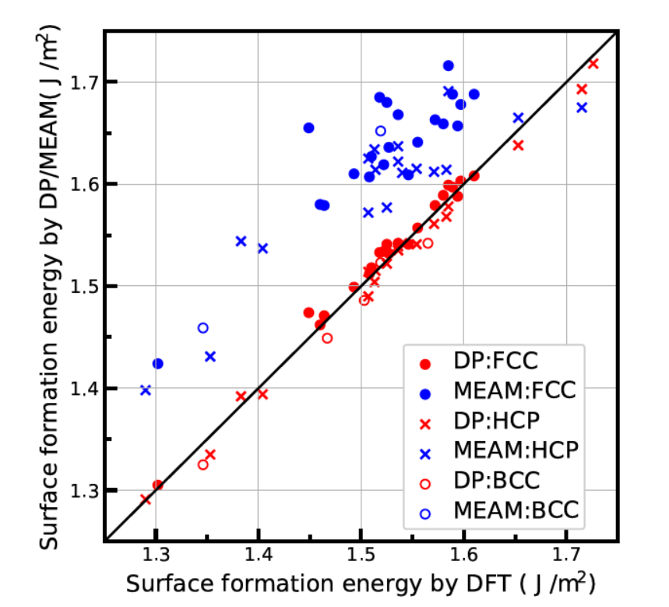
Examples : Cu
Notes:
surface formation energy Esf((hkl)), which describes the energy needed to create a surface with Miller indices (hkl) for a given crystal

Slide 19
Conclusion
DP-GEN: a scalable and flexible platform
The 3 steps are separate and highly modularized
Describe various systems: organic molecules, metals, semiconductors, and insulators…
Applicable to different software and operating systems

